Slide 1
My research and Graduate life
Kalani Hasanthika

Slide 2
Mixture models

Slide 3
Mixture models
Probabilistic models for representing the presence of subpopulations within an overall population
Generally, does not require knowing which subpopulation a data point belongs to
Used to make statistical inferences about the properties of the sub-populations given only observations on the pooled population
A form of unsupervised learning

Slide 4
Some real-world applications
Financial modeling
Machine Learning topics
Speech recognition systems
Handwriting recognition
Tracking of multiple objects in a video sequence
Breast cancer prognosis

Slide 5
The two most common choices of distributions
Gaussian aka "normal" (for real-valued observations)
Categorical (for discrete observations)
Poisson
Negative Binomial

Slide 6

Gaussian mixture models
$z$ - Latent variable (hidden variable) with $K$ groups
For latent variable (hidden variable) group $k$,
$P\left(z=k\right)=π_{k}$​
Where $\sum_{k=1}^{K}{π_{k}=1}$ and $π_{k}≥0$ for $k=\left\{1,…, K\right\}$
Observations $y$ for the $k^{th}$ latent variable group has a Gaussian distribution with mean of $μ_{k}$ and variance of $σ_{k}^{2}$
$$P\left(y|z=k\right)=N\left(y | μ_{k},σ_{k}\right)=\frac{1}{σ_{k}\sqrt{2π}}e^{−\frac{1}{2}{\left(\frac{y−μ_{k}}{σ_{k}}\right)}^{2}}$$

Slide 7

Parameter estimation
Joint distribution:
$$P\left(y\right)=\sum_{k=1}^{K}{P\left(z=k\right)×P\left(y | z=k\right)}=\sum_{k=1}^{K}{π_{k}N\left(y | μ_{k},σ_{k}\right)}$$
Log-likelihood:
$$l\left(π,μ,σ\right)=\ln{P\left(y | π,μ,σ\right)}=\ln{\sum_{i=1}^{N}{P\left(y_{i} | π,μ,σ\right)}}$$
$$=\sum_{i=1}^{N}{\ln{\sum_{k=1}^{K}{P\left(z_{i}=k\right)×P\left(y_{i} | z_{i}=k,μ_{k},σ_{k}\right)}}}$$
$$=\sum_{i=1}^{N}{\ln{\sum_{k=1}^{K}{π_{k}N\left(y_{i} | μ_{k},σ_{k}\right)}}}$$

Slide 8

Parameter estimation
Optimize the log-likelihood function
Note: We have a hidden variable $z_{i}$ for every observation
Cannot use method like maximum likelihood estimation (MLE)

Slide 9
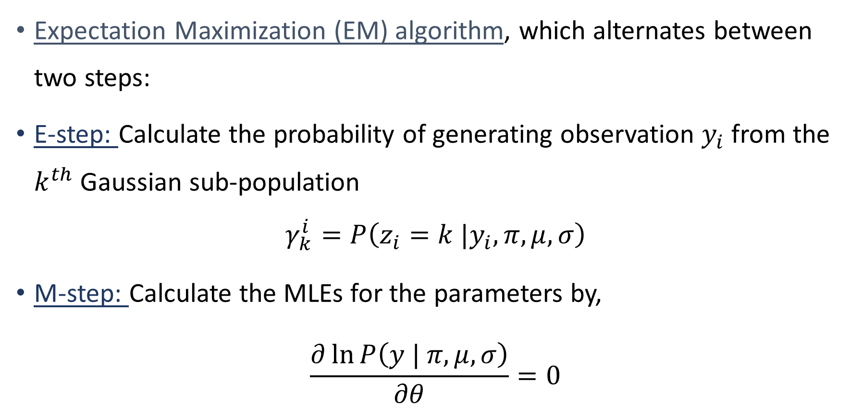
Expectation Maximization (EM) algorithm, which alternates between two steps:
E-step: Calculate the probability of generating observation $y_{i}$ from the $k^{th}$ Gaussian sub-population
$$γ_{k}^{i}=P\left(z_{i}=k |y_{i},π,μ,σ\right)$$
M-step: Calculate the MLEs for the parameters by,
$$\frac{∂\ln{P\left(y | π,μ,σ\right)}}{∂θ}=0$$

Slide 10

$$\hat{μ_{k}}=\frac{1}{N_{k}}\sum_{i=1}^{N}{γ_{k}^{i}y_{i}}$$
Where $N_{k}=\sum_{i=1}^{N}{γ_{k}^{i}}$
$$\hat{σ_{k}}=\frac{1}{N_{k}}\sum_{i=1}^{N}{γ_{k}^{i}{\left(y_{i}−\hat{μ_{k}}\right)}^{2}}$$
$$\hat{π_{k}}=\frac{N_{k}}{N}$$

Slide 11
Negative binomial mixture regression model

Slide 12
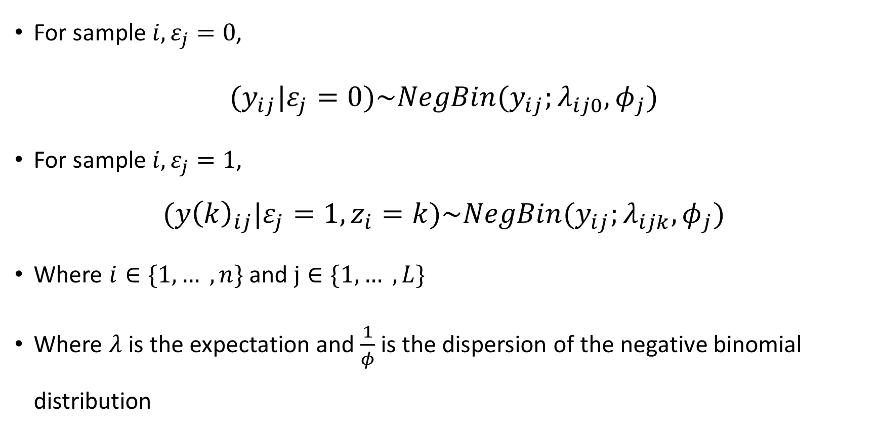
For sample $i,ε_{j}=0$,
$(y_{ij}|ε_{j}=0)\sim NegBin(y_{ij};λ_{ij0},φ_{j})$
For sample $i,ε_{j}=1$,
$${(y\left(k\right)}_{ij}|ε_{j}=1,z_{i}=k)\sim NegBin(y_{ij};λ_{ijk},φ_{j})$$
Where $i∈\{1, … ,n\}$ and $j∈\{1, … ,L\}$
Where $λ$ is the expectation and $\frac{1}{φ}$is the dispersion of the negative binomial distribution

Slide 13

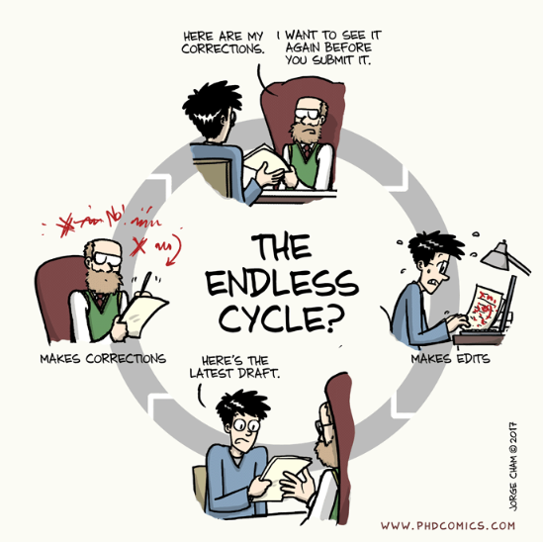
Graduate life

Slide 14
The format of learning may be different
Think through problems and puzzles in new ways
Produce your own research questions to tackle
Your classes will likely be heavier on reading, writing, and open discussions but lighter on the traditional lecture styles

Slide 15
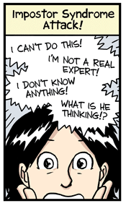
Imposter syndrome is real - and wrong!
Feeling of believing that they do not truly belong in their programs.
Can be isolating
Common among graduate students
Others are probably feeling the same way you are and try to remind yourself that it is difficult for everyone.

Slide 16
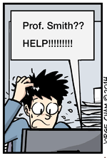
Don’t be afraid to ask for help!
It is okay to ask for help.
Fear being the person that asks the “dumb” question.
It is much better to ask for clarification than to trek on blindly and make mistakes
Older graduate students and your cohort members are great resources
Get comfortable

Slide 17
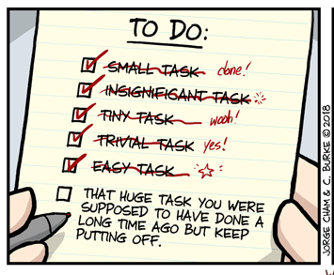
Learn to plan your time carefully
Graduate studies are more intensive and more time-consuming
Push yourself to develop good time management skills early on
Set your own hours of work throughout the week
Commit yourself to respecting those hours
Make sure give yourself adequate breaks throughout the week.
Preventing burn out is important!

Slide 18
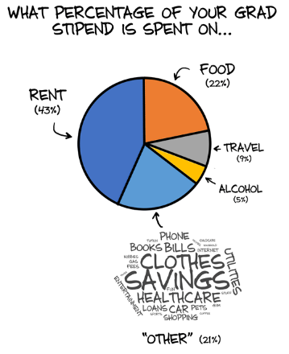
Tips!
Be aware of the financial commitment
Get involved in research
Consider going to therapy
Think about the type of advisor you want to have
Make sure you’re passionate about the work
Think about the future
Use your practicum and internship opportunities wisely
Don’t lose your sense of humor!

Slide 19
Know that you’ve got this!

Slide 20
Questions

Slide 21
Thank you

